Slide 1
ANN for Concrete Strength prediction

Slide 2
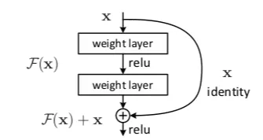
Residual Neural Network (ResNet)
For including more features and deeper network
Solving the vanishing gradient problem

Slide 3
Residual Neural Network
Regular ANN vs ResNet
Using more hidden layers
Using entire features of US dataset
Activation function: Hyperbolic tangent
Loss function: Mean square error

Slide 4
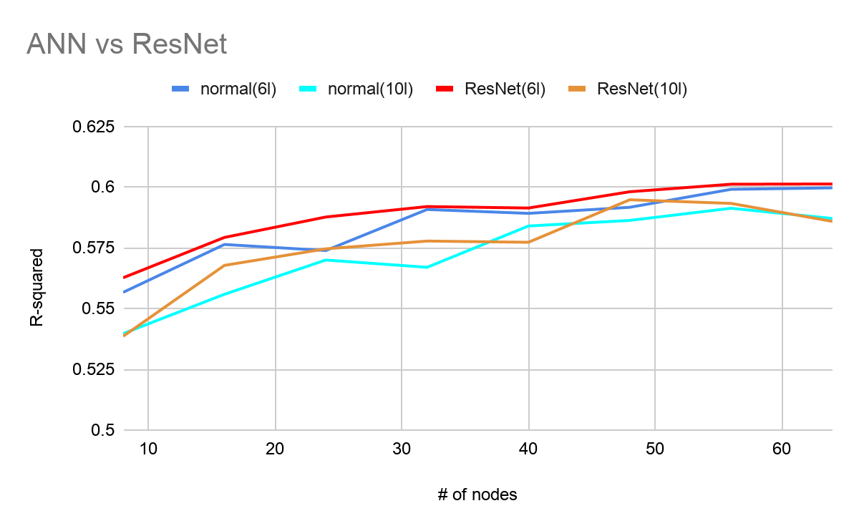
Residual Neural Network

